Slide 1




Content Analysis
Presentation

Slide 2


Today's agenda
Project recap
Problem
The Analytics team
Process
Insights
Summary

Slide 3

Social Buzz, a social media company focused on tracking users reactions- has rapidly expanded since its inception. To effectively oversee their massive scale within recent years, Social Buzz has engaged Accenture for 3 months with the following tasks;
Audit Social Buzz big data practice
Recommendation for a successful IPO
In-depth analysis of Social Buzz popular content with visualization – Focusing on the top 5 by aggregate popularity
Project Recap

Slide 4
Social Buzz, a rapidly growing social media and content creation platform, in overcoming critical challenges. The company faces issues of managing immense data volumes, resource constraints despite its exponential growth, and the impending complexity of preparing for an Initial Public Offering (IPO). Founded in 2010 by former engineers from a prominent social media conglomerate, Social Buzz emphasizes content over individual user identity, garnering over 500 million active monthly users. With the majority of its workforce dedicated to technical operations, Social Buzz now seeks external expertise to navigate its scaling demands and ensure a successful transition to a publicly traded company.
Problem

Slide 5
1
Andrew Fleming
Chief Technical Architect
The Analytics team
2
Marcus Rompton
Senior Principal
3
Vikant kumar
Data Analyst

Slide 6
1
Understand Business Problem
2
Data Cleaning
Process
3
Data Modeling
4
Data Exploration & Analysis
5
Data Visualization & Recommendation

Slide 7

Key Insights
16
4
1897
May
MONTH WITH HIGHEST POSTS
UNIQUE CATEGORY
TYPES OF CONTENT
REACTIONS TO “ANIMAL” POSTS

Slide 8
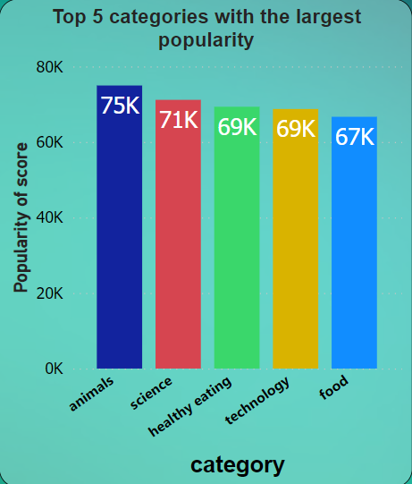
Key Findings

Slide 9
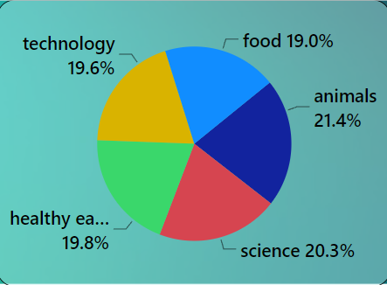
Top category by percentage

Slide 10
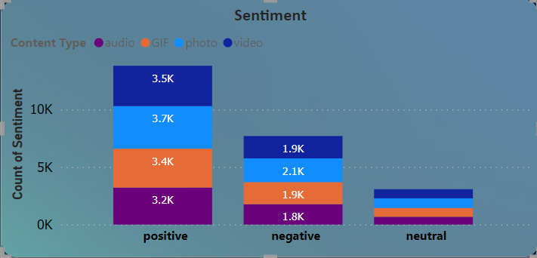

Slide 11
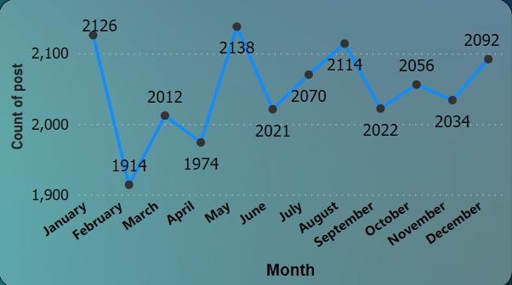
Total post by month

Slide 12
In summary, our analysis identified the top 5 content categories driving popularity on Social Buzz: Animals, Food, Healthy Eating, Science, and Technology. By understanding user sentiment and content preferences, Social Buzz can capitalize on these categories to enhance engagement and platform success. Implementing sentiment analysis tools and continuously monitoring content trends will be crucial for sustained growth and competitiveness in the social media landscape.
Summary

Slide 13


Thank you!
ANY QUESTIONS?

